Slide 1
Comparative Law
Prof.ssa Letizia Coppo
Cattedra di Diritto comparato
A.A. 2022-2023

Slide 2
THE COURSE IN A NUTSHELL
Course structure and essentials
60 hours, 10 weeks
lectures + more interactive activities
regular attendance highly recommended
possible extra seminars
class notes + suggested readings
students attending on a regular basis: the final exam will be oral and in English language. Students who regularly attended the lectures will be entitled to undertake a preliminary test on part of the programme. Admission is subdued to the condition that the student has not failed to attend more than 3 lectures before the date of the test. Assessment will be in numbers (from 18 to 30 cum laude). Students who pass the test will be entitled to choose between undertaking the final exam only on the remaining part of the programme (in this case the score of the preliminary test will be part of the final score) or undertaking the final exam on the whole programme (in this case the score of the preliminary test will be considered as refused). The students who passed the preliminary test but failed to attend more than 6 lectures before the end of the course will in any case lose the benefit of undertaking the final exam on a reduced programme.
students non attending on a regular basis: oral exam in English at the end of the course.

Slide 3
THE COURSE IN A NUTSHELL
What are we talking about?
After a first part devoted to the concept of comparative law, to the role of that science and the comparative law method, the course will analyse, in a synchronic and diachronic perspective the distinctive elements of the main legal systems of the world, namely the Western legal tradition, with its paramount distinction between civil law and common law; the Eastern legal tradition and the religion-based legal traditions (Islamic law, African law, Chinese law, Hindu law).

Slide 4
THE COURSE IN A NUTSHELL
What for?
The technological revolution reduced the physical distance among countries, encouraging people to travel cross-borders
The digital revolution increased the transnational dimension of exchanges.
⚖️ LAW GLOBALISATION 🌏

Slide 5
THE COURSE IN A NUTSHELL
What for?
Circulation of laws (the so-called legal transplants)
Need for uniformity and harmonisation
Sources pluralism and complexity
Circulation of contractual models (‘alien contracts’)
Transfer of functions from the State to the Market
Creation of a ‘third legal order’ named lex mercatoria
Cultural cross-contamination

Slide 6
THE COURSE IN A NUTSHELL
What for?
Providing knowledge 🧐
Extending and enriching the ‘supply of solutions’ 🍰 🎂
Improving the scholars’ critical capacity to find the best one 🔍 💡

Slide 7
THE COURSE IN A NUTSHELL
What for?
an aid to the legislator
a useful tool of construction
a fundamental step of legal education
a tool for law unification and harmonisation
a glimpse into the common roots of the European legal tradition

Slide 8
THE COURSE IN A NUTSHELL
What do I expect from you?
Develop legal English skills
Learn the methods of macro and micro comparison
Become familiar with the main legal formants influencing the evolution of private law
Develop sensitivity for law harmonization

Slide 9
THE COURSE IN A NUTSHELL
What can you expect from me?
Dialogue and discussion; care for legal reasoning and critical thinking
Accuracy in the legal vocabulary
Understanding of possible language and law related difficulties
Monitoring and mentoring

Slide 10
LET US BEGIN OUR JOURNEY!!!
Credits: L’Atelier che non c’è di Michele Battistella

Slide 11
The comparative method
Golden rules

Slide 12
THE COMPARATIVE METHOD
Golden rules
Starting point: legal rules are not identical anywhere in the world and the solutions adopted to legal problems vary from system to system.
Definition of comparative law: the science that studies law (i.e. the different legal systems of the world*) through the comparative method.
*a legal system is more than just a set of legal rules; and law is not reduced to legislation

Slide 13
THE COMPARATIVE METHOD
Golden rules
Macro-comparison: comparison on a large scale; it deals with the spirit and style of different legal systems, i.e. methods of handling legal materials, procedures for resolving and deciding disputes or the role of the various legal players, and the like.
Micro-comparison: comparison on a small scale, i.e. focused specific legal institutions or problems, in other words, on the rules applied to actual problems or particular conflict of interests

Slide 14
THE COMPARATIVE METHOD
Golden rules
Legal systems may have formally identical rules and though solve the same problem in different ways; or have formally different rules and reach the same results in their application.
⚠️ comparison must never be restricted to normative provisions or remain confined to a formal level. One thing are rules, another one is how they are interpreted and applied.

Slide 15
THE COMPARATIVE METHOD
Golden rules
Legal formants: a legal system is the result of the interaction among various forces or factors that mutually influence each others.
We must learn how to:
distinguish between operational rules and how the rules are conveyed
discern the various formants and understand their role

Slide 16
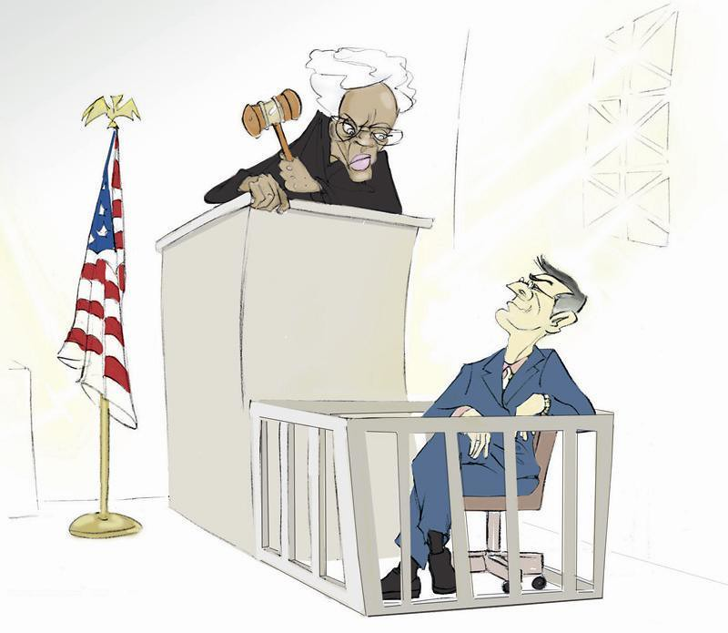
THE COMPARATIVE METHOD: GOLDEN RULES
Main legal formants
Legislation
Scholarship
Case-law

Slide 17
THE COMPARATIVE METHOD: GOLDEN RULES
Criticalities
Formants often overlap, raising problems of legitimacy, and often contain other formants (e.g. in judicial decisions we can distinguish between the held, the applied rule, the ratio decidendi and the obiter dictum)
Each system has its crypto-types

Slide 18
THE COMPARATIVE METHOD: GOLDEN RULES
Crypto-types
Formants which are implied in the system (and may be expressed in other systems); one thing is following rules, another is being aware of them.

Slide 19
THE COMPARATIVE METHOD: GOLDEN RULES
Steps of the comparative method process
Choose what systems to compare (i.e. the term of comparison): here the key-word is functionality, which tells you what laws to compare and the scope of the undertaking
Identify the legal problems you want to compare and contrast (i.e. the object of comparison)
Identify the relevant material and sources for comparison (i.e. where to look in the foreign systems)
Build a system
Assess findings critically

Slide 20
THE COMPARATIVE METHOD: GOLDEN RULES
1. The choice of the term of comparison
Focus on the parent system rather than / prior to the affiliate system (but bear in mind that to qualify a system as a mere affiliate is a delicate matter)
First look at the parent system of the great legal families
Choose according to the features of each system and the nature of the problem you want to analyse (have a look at national law reviews to get a grasp of hot topics)

Slide 21
THE COMPARATIVE METHOD: GOLDEN RULES
2. The choice of the object of comparison
Do not jump to the conclusion that the problem is unknown to the foreign system
Rethink the original question purging it of all dogma from your system
Eradicate preconceptions of your native legal system
Do not underestimate the refinement of non continental legal system (see the example of trust)
If the problem is really is unknown, then wonder why

Slide 22
THE COMPARATIVE METHOD: GOLDEN RULES
3. The choice of the sources and materials to compare
Avoid all limitations and restraints, especially with reference to sources (both imagination and discipline are needed)
Bear in mind that sometimes legal systems solve problems with extra-legal means (see the example of the sending/receipt rule as to the question when an offer is considered as binging).
Presumption of similarity: tells you where to look and whether convergences and divergences are real or only apparent.

Slide 23
THE COMPARATIVE METHOD: GOLDEN RULES
4. The building of a system
Draft separate reports for all the legal systems you have compared
Comment each report
Adopt a new viewpoint freeing each solution from their context and looking at them in light of their functions
Develop a special syntax and vocabulary with concepts wide enough to embrace heterogeneous legal institutions functionally comparable
Check the coherence of the system

Slide 24
THE COMPARATIVE METHOD: GOLDEN RULES
5. The critical assessment of findings
Build a structure and all the conceptual apparatus for ordering, organising and transmitting its materials after having induced it through constant experiments of comparative law.
Create topical and categories

Slide 25
THE COMPARATIVE METHOD: GOLDEN RULES
Language-related criticalities
Sometimes systems use concepts or words that do not find their mirror ones in other systems, as they do not belong to their legal categories or legal vocabulary (e.g. equity, tzar …). What must be borne in mind is that legal concepts belong to two systems: the linguistic and the legal one.
Problems of translation: different systems have different linguistic structures and different rhetoric figures (e.g. contract and contrat) and they are full of false friends and traps

Slide 26
THE COMPARATIVE METHOD: GOLDEN RULES
Possible solutions to translation problems
Sometimes it is better not to translate the concept, leave it in its original language
Sometimes there is a semantic and conceptual correspondence
Sometimes it is necessary to measure the divergence in meaning and assess whether it undermines the understanding of the concept
Sometimes a neologism is needed

Slide 27
The comparative method
Benefits and practical applications

Slide 28
THE COMPARATIVE METHOD: BENEFITS & APPLICATIONS
The comparative method as an aid to the legislator
Legislators have found that on many matters good laws cannot be produced without the assistance of comparative law, whether in the form of general studies or of reports specially prepared in the topic in question.
Instances: XIX century unification of German Law (private law, civil procedure, criminal law, bankruptcy law, court system organisation); dissolution of former Soviet Union countries.

Slide 29
THE COMPARATIVE METHOD: BENEFITS & APPLICATIONS
The comparative method as a tool for interpretation
Key question: are national jurists entitled to a comparative-law-oriented or a harmonisation-oriented interpretation of domestic legislation?
Possible answer
Such interpretation cannot turn into a circumvention of national law.
So, jurists are entitled to such interpretation provided that they use it to fill the gaps of domestic law.
Regardless of gaps, comparative interpretation can always be an argument to select between the two possible meanings of an ambiguous provision.

Slide 30
THE COMPARATIVE METHOD: BENEFITS & APPLICATIONS
The comparative method as a tool for interpretation
comparative-law-oriented or harmonisation-oriented interpretation seems to be allowed in some countries*
* As to legislation, see the Swiss Civil Code, art. 1, pars 2 e 3: 🇨🇭
«if no statutory provisions can be found, the judge must apply customary law, failing which he must decide according to the rule he would, were he a legislator, decide to adopt. In so doing the judge must follow accepted doctrine and tradition».

Slide 31
THE COMPARATIVE METHOD: BENEFITS & APPLICATIONS
The comparative method as a tool for interpretation
And actually courts do use comparative law as an interpretative tool in many cases, also through the quotation of foreign precedents*
See, e.g. the influence of French case-law on the issue of wrongful birth / wrongful life.
Or see the English case Interfoto Picture Library v. Stiletto Visual Programmes (available within the course materials), about good faith in precontractual negotiations.

Slide 32
THE COMPARATIVE METHOD: BENEFITS & APPLICATIONS
A fundamental step in legal education
Improved awareness and respect of other cultures
Better understanding of domestic law
Learning of practical skills useful for facing the challenges of the globalisation of legal professions.

Slide 33
THE COMPARATIVE METHOD: BENEFITS & APPLICATIONS
A tool for law unification or harmonisation
In identifying the real and apparent convergences and divergences among the various legal systems and reporting them, comparative law experts play a paramount role in promoting the unification and harmonisation of law.
Think of scholarly initiatives like Unidroit or PECL or UNCITRAL or the Common Core; or think of the CISG Advisory Council or the Lawyer Linguists working at the European Union.

Slide 34
Prof.ssa Letizia Coppo
Email: lcoppo1@lumsa.it
lcoppo@univ-catholyon.f
r

