Slide 1
Comparative Law
Prof.ssa Letizia Coppo
Cattedra di Diritto comparato
A.A. 2022-2023

Slide 2
THE MAIN EUROPEAN CIVIL CODES

Slide 3
The French civil code

Slide 4
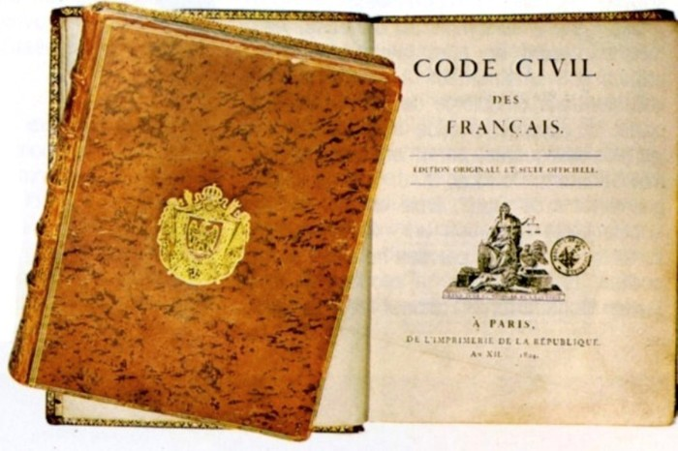
THE FRENCH CIVIL CODE
«Ma vraie gloire n'est pas d'avoir gagné quarante batailles; Waterloo effacera le souvenir de tant de victoires; ce que rien n'effacera, ce qui vivra éternellement, c'est mon Code civil»(Napoléon)

Slide 5
THE FRENCH CIVIL CODE
The structure
Preliminary title: of the publication, effects and application of legislation in general.
Book I: of persons
Book II: of goods and the different modifications of property
Book III: of the different ways to acquire property.
Book IV: of sureties
Book V: provisions applicable to Mayotte

Slide 6
THE FRENCH CIVIL CODE
The structure
PRELIMINARY TITLE – it is focused on the sources of law, not on institutions that are common to the whole of private law, unlike the general part of the BGB.
BOOK I – it does not follow the chronological order of people’s life or begins with the distinction between natural persons and legal persons, but it begins with the relationship between persons, as French citizens or nationals, and the State, in particular with civil rights and then with the French nationality and then the civil state. The book continues with marriage, of which some rules are contained in book III, divorce, filiation, parental authority, guardianship, the measures for the protection of incapable persons. What follows is the regime of cohabitation and the measures against domestic violence.

Slide 7
THE FRENCH CIVIL CODE
The structure
BOOK II – it begins with the classification of goods, as drawn by Roman law, and follows with the concept of property and other rights on land (usufruct, habitation, servitudes…) also coming from Roman law. Publicity in real estate records has no separate regime, but is contained in this very book.
BOOK III – title I is devoted to successions, II to liberalities, III to the sources of obligations (contract: preliminary provisions, formation, interpretation, effects, tort liability - which is atypical; other sources of obligations, like unjust enrichment), title IV is devoted to the general provisions on obligations, IV-bis to the proof of obligations, titles V-XVII to special contracts, the first of which is marriage. Title XX is devoted to time limitation of rights; title XXI comes back on the ways to acquire property providing original title ways (occupation, usucapion and possession stands for title).

Slide 8
THE FRENCH CIVIL CODE
The making of
After the several drafts by Cambacérès, Napoleon appointed a commission of 4 persons (expert practitioners, not academics) for the final draft of the French Civil code.
2 representatives of droit coutumier: Tronchet; Bigot de Préameneu
2 representatives of droit écrit: Portalis; Maleville
After only 4 months, the Draft was ready. The text was divided into sections submitted to the legislative process separately.
On the 31st March 1804 the ‘Code Civil des Français’ was promulgated

Slide 9
THE FRENCH CIVIL CODE
Napoleon’s role
He was an elegant and refined man, but also a concrete man, a soldier.
He put an abrupt end to hair-splitting discussions.
He advocated a simple and transparent drafting style, capable of making concepts intelligible also to non-experts
He brought in the Code also his personal experience
Idea of a strong patriarchal family to mirror the organisation of the State, with Napoléon, as the father of the Nation, on top.
Divorce for mutual consent (he divorced from Josephine Beauharnais)

Slide 10
THE FRENCH CIVIL CODE
The spirit and the essentials
While Prussian and Austrian Codes were dictated by an enlightened despot, the French Civil code was a bourgeois Code, a product of the French Revolution.
Nevertheless, it rested on a large number of traditional institutions, such as freedom of contract and ownership.

Slide 11
THE FRENCH CIVIL CODE
The spirit and the essentials
The Code maintained some revolutionary achievements coming from droit intermédiaire
Equal division of estates
Complete secularisation of marriage
Abolition of feudal servitudes
But it resized and downsized several rules
It reduced the grounds for divorce
It re-established the freedom of testament and donation, but within the limits of the ‘quotité disponible’.

Slide 12
THE FRENCH CIVIL CODE
The spirit and the essentials
The Code reached a reasonable and balanced compromise between droit écrit and droit coutumier.
Droit écrit: contract law; law of wills; dowry, contractual property regime was nearly modelled on Roman law.
Droit coutumier: family and inheritance law; forced inheritance of relatives; community of movables; possession vaut titre.

Slide 13
THE FRENCH CIVIL CODE
The heritage
The wide use of general clauses and open formula is what allowed the Code civil to survive (see abus de droit; clauses exonératoires de la responsabilité; law of delicts).
École de l’exégèse: grammatical and logical study of the Code.
École de la libre recherche scientifique: interpretation of the Code in light of the needs expressed by society.

Slide 14
THE FRENCH CIVIL CODE
The reforms
2004 – Divorce
2005 – Filiation; sureties
2006 – Successions and donations
2007 – Legal capacity and guardianship
2008 – Time limitation of rights
2009 – Filiation
2013 – Marriage (extension to PACS)
2016 – Obligations and contract law

Slide 15
The German civil code

Slide 16
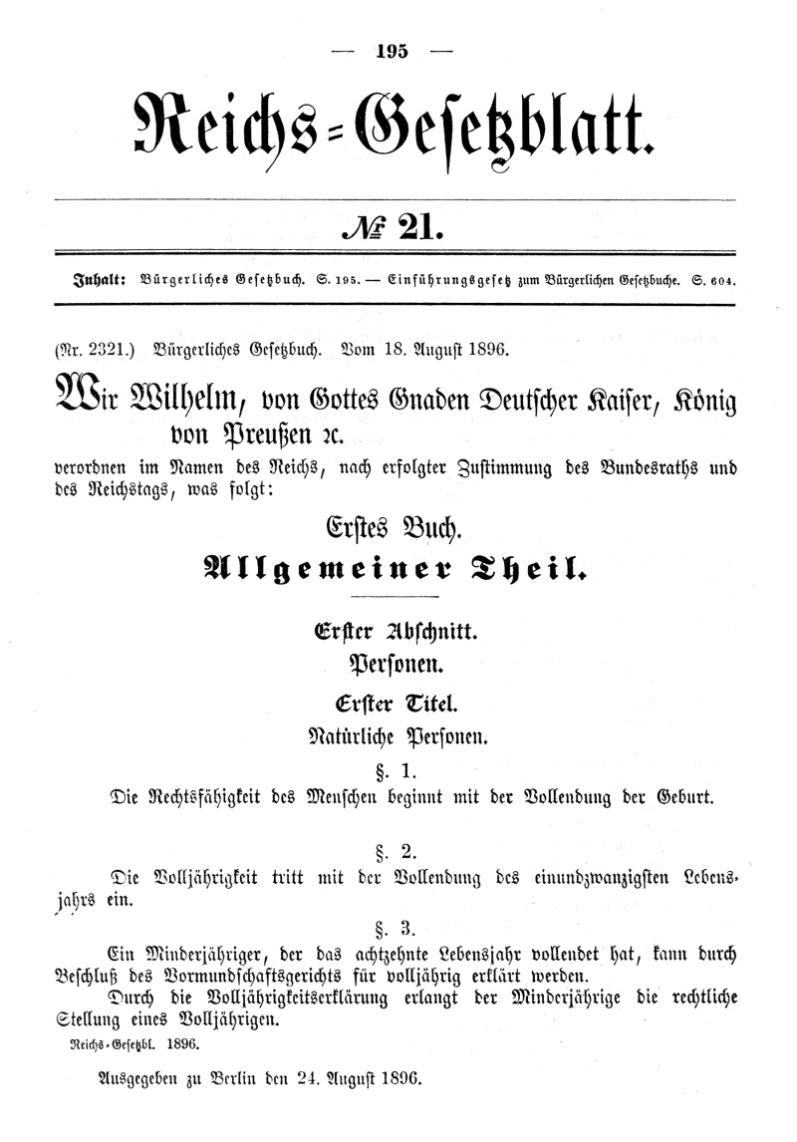
THE GERMAN CIVIL CODE
1900, being unreformed until 2001

Slide 17
THE GERMAN CIVIL CODE (BGB)
The structure
Book I. Allgemeiner Teil (general part)
Book II. Recht der Schuldverhältnisse (law of obligations)
Book III. Sachenrecht (law of property)
Book IV. Familienrecht (family law)
Book V. Erbrecht (law of successions)

Slide 18
THE GERMAN CIVIL CODE (BGB)
The structure
Book I. Allgemeiner Teil (general part): It does not contain general rules about the exercise of rights in society or basic principles in the construction of statutes, customary law, the powers of judges or burden of proof.
Instead it contains certain basic institutions common to the whole of private law, which are recurring throughout all the other books of the BGB.

Slide 19
THE GERMAN CIVIL CODE (BGB)
The structure
Book I. Allgemeiner Teil (general part):
Division 1: persons
Title 1: natural persons, consumers, entrepreneurs (it begins with legal capacity)
Title 2: legal persons (divided into types: associations, foundations…)
Division 2: things and animals (beginning with definitions and classifications, in line with Pandects)
Division 3: legal acts (négoce juridiques) – capacity to contract, declarations of will, contract, conditions and time periods, agency (on this see below).
Division 4: time periods and dates
Division 5: time limitation of rights
Division 6: sureties

Slide 20
THE GERMAN CIVIL CODE (BGB)
The structure
Pros and cons of Allgemeiner Teil
The fact of providing rules in a preliminary and general part constantly raises doubts about their scope of application.
Sometimes such a location can be misleading for novices and foreign lawyers, as they would expect to find certain rules in a different place.
Great fascination on foreign jurists, mostly for teaching (see Saleilles, Austin and the Allgemeine Rechtlehre).

Slide 21
THE GERMAN CIVIL CODE (BGB)
Contract law and the evolution of the BGB
It is dominated by the bourgeois idea that contracting parties are formally free and equal.
Key principles: freedom of contract/party autonomy and the duty to keep one’s promises.
Voidness when the contract is against bonos mores or if one party unfairly exploited the inexperience or lack of judgment of the other.

Slide 22
THE GERMAN CIVIL CODE (BGB)
Contract law and the evolution of the BGB
The code proved inadequate to face social challenges as the bourgeois state gave way to the social democracy.
Judges and legislators had to qualify and limit the liberal principles of contract law, wherever they gave one party the power to threaten the basic conditions for a decent life which must be guaranteed by the social state.
Legislators enacted special statutes; judges used general clauses.

Slide 23
THE GERMAN CIVIL CODE (BGB)
Contract law and the evolution of the BGB
Legislative interventions: special statutes on housing, tenancies, agricultural holdings and most of all labour.
General clauses: Treu und Glaube (Good faith); rebus sic stantibus; abuse of rights; Wegfall der Geschäftsgrundlage (Fall of the ground of the transaction); prohibition of venire contra factum proprium.
Applications: control on liability limitation clauses in GTC; impossibility to perform (Unzumutbarkeit, Unmöglichkeit); duties of protection (Schutzpflichten).

Slide 24
THE GERMAN CIVIL CODE (BGB)
The making of
In 1874 a first commission was appointed for the drafting of the Code, composed of 11 members (judges, officials of the Ministry, Professors, among which Windscheid, but no lawyers).
The commission worked in seclusion, without any public consultation. The first draft was published 13 years after, in 1887.
As soon as the draft was published, it had been subject to bitter criticism due to its scholastic structure, abstract conceptualism, accurate but hardly accessible legal wording and complex system of cross-references.
A second commission was appointed in 1890, including few layman, but no major changes were made.

Slide 25
THE GERMAN CIVIL CODE (BGB)
The spirit and essentials
The BGB was enacted in a period of relative social and political stability, so their spirit is retrospective and reflective, conservative: it seeks to maintain a situation favourable to the establishment.
The BGB reflects the social model of Bismark’s Empire: he was a liberal bourgeois who created the German nation by cooperating with Prussia’s conservative authoritarianism.
The Code was infused with a marked liberalism and the belief that the general good would spontaneously flow from the interplay of economic forces, provided that the State did not interfere.
But the drafters of the BGB were blind to the great social changes and challenges that were affecting Germany between the 1870s and 1880s.

Slide 26
THE GERMAN CIVIL CODE (BGB)
The spirit and essentials
Language, method and conceptual structure: it came from Pandectist school. The BGB is not addressed to citizens, but to lawyers; it waived whatever ambition of educating its lay readers.
Key-words: accuracy and rigour of thought; clarity; exhaustiveness; but complex syntax and sometimes gothic style. The BGB was the ‘legal calculating machine par excellence’.

Slide 27
THE GERMAN CIVIL CODE (BGB)
The heritage: the teaching of private law by categories
Persons
Goods
Acts/facts
Relationships
Occurrences (constitutive, modificative, extinctive)
Qualities

Slide 28
THE GERMAN CIVIL CODE (BGB)
The heritage: the teaching of private law by categories
Subjective legal positions

Slide 29
THE GERMAN CIVIL CODE (BGB)
The heritage: the teaching of private law by categories
Legal facts: all event that produces legal effects.
Material facts: events being independent from human will the occurrence of which produces a modification of reality with legal consequences (birth, death…).
Legal acts: any human action or omission for which the system provides legal effects.
Legal acts stricto sensu: any human act which is undertaken consciously and willingly, the effects of which are not dependent from human will but from the law (letter of formal notice, payment of a debt).
Négoces juridiques: any declaration through which persons express their will to regulate their interests in a certain way and produce certain legal effects (contract, testament, marriage…).
Declarations of science: any declaration through which persons communicate the knowledge of a fact or situation which is legally relevant (confession, acknowledgement of paternity…).

Slide 30
THE GERMAN CIVIL CODE (BGB)
The heritage: the general theory of negozio giuridico
Starting point: contract, marriage, testament, exc., all share the feature of being declarations of will (unilateral, bilateral or multilateral) through which the persons announce the legal effects that they want to obtain (transfer of property, transfer of assets after death…). In all those cases the person’s will produces legal effects by creating, modifying or ending a certain legal situation.
Definition: the legal négoce is a declaration of will through which a person announces the legal effects pursued and to which the legal system connects the production of the desired effects, provided that they are compliant with the legal ordering itself.

Slide 31
THE GERMAN CIVIL CODE (BGB)
The heritage: the general theory of negozio giuridico
We haven’t got, either in the French or in the Italian civil code, any provisions on the négoce juridique; it is not a normative category but it is very important from a theoretical viewpoint. Instead, we have provisions on contract law in general, that are applicable, as long as compatible, also to unilateral acts.
Classification of négoces juridiques
As to their structure: unilateral, bilateral, multilateral, collegial, complex acts
As to their function: mortis causa/inter vivos; patrimonial (onerous or gratuitous)/non patrimonial; acts of disposition (translative, abdicative, constitutive) or acts of obligation; acts of ascertainment

Slide 32
THE GERMAN CIVIL CODE (BGB)
The heritage: the general theory of negozio giuridico
The elements of négoce juridique:
essential elements: their lack makes the act invalid;
ancillary elements: their presence or absence has an impact only on the effectiveness of the contract;
natural elements: they are legally typical for certain acts, so they apply as defaults, whenever they are not derogated from by the parties.

Slide 33
THE GERMAN CIVIL CODE (BGB)
The heritage: the general theory of negozio giuridico
The pillar of négoce juridique: the declaration of will
1) Tacit declaration
2) Express declaration
Oral form
Written form ad sustantiam (i.e. for validity) or ad probationem (i.e. for evidence)
Bound under seal (forme écrite solennelle)
Conventional form
3) Silence

Slide 34
THE GERMAN CIVIL CODE (BGB)
The heritage: the general theory of negozio giuridico
The pillar of negozio giuridico: the declaration of will
The problem of the defects of consent
The problem, of publicity of legal acts: constitutive publicity, declarative publicity, informative publicity.

Slide 35
Prof.ssa
Letizia
Coppo
Email: l.coppo1@lumsa.it
lcoppo@univ-catholyon.fr

