Slide 1
Comparative Law
Prof.ssa Letizia Coppo

Slide 2
THE ROMANISTIC LEGAL FAMILY
FRENCH LAW

Slide 3
THE MAKING OF THE CODE NAPOLÉON
After the several drafts by Cambacérès, Napoleon appointed a commission of 4 persons (expert practitioners, not academics) for the final draft of the French Civil code.
2 representatives of droit coutumier: Tronchet; Bigot de Préameneu
2 representatives of droit écrit: Portalis; Maleville

Slide 4
THE MAKING OF THE CODE NAPOLÉON
After only 4 months, the Draft was ready. The text was divided into sections submitted to the legislative process separately.
On the 31st March 1804 the ‘Code Civil des Français’ was promulgated

Slide 5
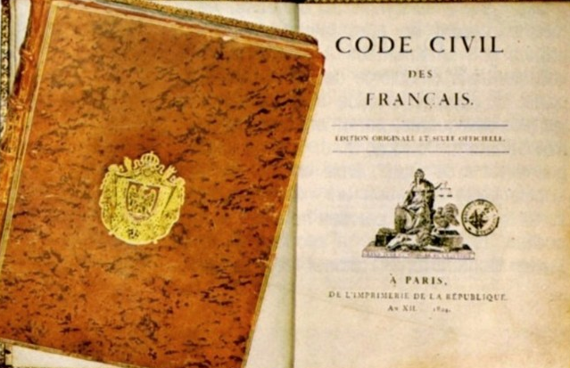
THE MAKING OF THE CODE NAPOLÉON
«Ma vraie gloire n'est pas d'avoir gagné quarante batailles; Waterloo effacera le souvenir de tant de victoires; ce que rien n'effacera, ce qui vivra éternellement, c'est mon Code civil»

Slide 6
THE MAKING OF THE CIVIL CODE
The Code civil opened the Age of Codifications
1806 Code of Civil Procedure
1807 Commercial Code
1808 Criminal Code
1808 Code of Criminal Procedure

Slide 7
THE MAKING OF CODE NAPOLÉON
Napoleon’s role
He was an elegant and refined man, but also a concrete man, a soldier.
He put an abrupt end to hair-splitting discussions.
He advocated a simple and transparent drafting style, capable of making concepts intelligible also to non-experts

Slide 8
THE MAKING OF THE CODE NAPOLÉON
Napoleon’s role
He brought in the Code also his personal experience
Idea of a strong patriarchal family to mirror the organisation of the State, with Napoléon, as the father of the Nation, on top.
Divorce for mutual consent (he divorced from Josephine Beauharnais)

Slide 9
THE SPIRIT AND ESSENTIAL FEATURES OF THE CODE NAPOLÉON
While Prussian and Austrian Codes were dictated by an enlightened despot, the French Civil code was a bourgeois Code, a product of the French Revolution.
Nevertheless, it rested on a large number of traditional institutions, such as freedom of contract and ownership.

Slide 10
THE SPIRIT AND ESSENTIAL FEATURES OF THE CODE NAPOLÉON
The Code maintained some revolutionary achievements coming from droit intermédiaire
Equal division of estates
Complete secularisation of marriage
Abolition of feudal servitudes
Prohibition of fideicommissary substitution

Slide 11
THE SPIRIT AND ESSENTIAL FEATURES OF THE CODE NAPOLÉON
But the Code resized and downsized several rules
It reduced the grounds for divorce
It re-established the freedom of testament and donation, but within the limits of the ‘quotité disponible’.

Slide 12
THE SPIRIT AND ESSENTIAL FEATURES OF THE CODE NAPOLÉON
The Code reached a reasonable and balanced compromise between droit écrit and droit coutumier.
Droit écrit: contract law; law of wills; dowry, contractual property regime was nearly modelled on Roman law.
Droit coutumier: family and inheritance law; forced inheritance of relatives; community of movables; possession vaut titre.

Slide 13
THE SPIRIT AND ESSENTIAL FEATURES OF THE CODE NAPOLÉON
Possible influence of natural law
Without jusnaturalism the very idea of a code would not have developed.
Spirit of moderation and wisdom.
Judge as ‘bouche de la loi’ and legislative ideology.
No ambition of completeness: wide use of general clauses.

Slide 14
THE STRUCTURE OF THE CODE NAPOLÉON
Preliminary title – Publication, effect and application of the laws in general
Book I. Persons
Book II. Property, and the Different Modifications of Property
Book III. The Different Modes of Acquiring Property
(see Annex 1)

Slide 15
THE HERITAGE OF THE CODE NAPOLÉON
The wide use of general clauses and open formula is what allowed the Code civil to survive (see abus de droit; clauses exonératoires de la responsabilité; law of delicts).
École de l’exégèse: grammatical and logical study of the Code.
École de la libre recherche scientifique: interpretation of the Code in light of the needs expressed by society.

Slide 16
THE REFORMS OF THE FRENCH CIVIL CODE
2006 – Successions and liberalities
2004 – Divorce
2005, 2009 – Filiation
2006 – Sureties
2007 – Capacity to act; guardianship
2008 – Statute of limitations
2013 – Marriage (extension to same-sex partnerships)
2016 – Obligations and contract law (see Annex III)

